Slide 1
Mobile & Web App Development Project Elixir Version 1.2 Modified 1st April, 2020

Slide 2
Why Mobile & Web App Development
An initiative that would enable the youth to use technology in their learning process
A tool to bring in “Gamification” into the learning process
A tool to have some quantitative view of the progress
The Mobile and Web App is expected to be a complimentary tool and it is intended to be used along with the sessions

Slide 3
High Level Requirements - Background
Creating Futures would like to use mobile and web technology to support our programs.
Therefore, this Web & Mobile app is expected to compliment us in the training programs that we conduct.
This app will not be a standalone training module, but will be used along the programs we conduct
We will start the development of this App with 2 modules
Aptitude Test
Spoken English

Slide 4
High Level Requirements – Aptitude Test
For aptitude test,
the students would log in
They would get a random number of questions. 20 questions.
The students answer these and submit
On click of submit, the app will give the student the results and the answers
This set of 20 questions will be randomly displayed each time the student takes the test.
Students need to log in with a username and password.
Students can take the test over a period of time. Therefore, we should store the test results

Slide 5
High Level Requirements – Spoken English
This should contain the following:
Spoken English (Through games)
Words (fill in the blanks, etc)
Sentences
Questions
Grammar
Listening to words, sentences, stories
Exercises based on Listening activity
Pronunciation of words
Writing
Reading
Having Conversations

Slide 6
High Level Requirements – General
Students will be given a mobile or a tablet with the app installed
In the CF Center, the Web App will be installed in all the laptops
Students will use this app for the various modules that CF has
The app should be able to track the progress of each student
There should be three types of users. Admin, teacher and students
Admin user will upload the questions and answers
Should be able to get basic reports for teachers and admin
Admin and teachers can access through online
This Web and Mobile app should work on offline mode
Should be intuitive and simple to use for the students
One mobile device should be able to cater to multiple students
Should be able to sync back to the main server when connect to Internet

Slide 7
Roles
Roles | Responsibility
Admin | Responsible for the overall application Creates / Edits questions based on the levels. Maintains the master list of questions Works outside the session
Teacher | Who runs the session and will have few features to run the session
System | The application
Student | Students who take the sessions

Slide 8
Feature List – Spoken English
Sl.No | User | Feature | Possible | Phase
1 | General | Log in Screen for Admin (Basic Authentication) Web Based | Y | Phase 1
2 | General | Change Password for Admin Web Based | Y | Phase 1
3 | Admin | Maintained list of Questions based on Category (Spoken English / Aptitude) Web Based | Y | Phase 1
4 | Admin | Upload of questions (web Based) Bulk Single | Y | Phase 1
5 | Admin | Manage Student details (Add & Edit) (web Based ) | Y | Phase 1
6 | Admin | Manage Teacher details (Add & Edit) (web Based ) | Y | Phase 1
7 | Admin | Manage Program & Session details (Add & Edit) (web Based ) | Y | Phase 1
8 | System | Have Questions for a program / session | Y | Phase 2
9 | System | Synchronize answers / performance for each student after the session. Download into excel
10 | System | Refresh / Clearing of a session data
11 | System | Work offline

Slide 9
Feature List – Spoken English
Sl.No | User | Feature | Possible | Phase
12 | Students | Log into Program / Session | Y | Phase 2
13 | Students | Answer Questions | Y | Phase 2
14 | System | Display Results and the Correct answers | Y | Phase 2
15 | System | Goes to next level based on “Pass” results. (The number of levels will be based on the question bank and the complexity of the questions) | Y | Phase 2
16 | System | Ability to retake the test | Y | Phase 2
17 | System | Should have the following Questions (detailed in later slides) Words (fill in the blanks, etc) Sentences Questions Match the following Riddles Crosswords
18 | System | Give Points / Rewards (Like a Game)
19 | Teacher | Able to register students during the session. Student Id to represent ProgramId->SessionId->StudentId
20 | Teacher | Ability to override some answers when there is a conflict (possible of having multiple correct answers)

Slide 10
Feature List – Spoken English
Sl.No | User | Feature | Possible | Phase
21 | Teacher | Able to pick questions set for each level for the session and start the session

Slide 11
About Questions
Questions will be for a Program -> Module -> Level
Spoken English -> Words -> Level0 -> Questions
To move to next level each student should finish all steps in each level
Score assessment will be done for each level

Slide 12
Question types (Spoken English)
Match the sentence and make single sentence
Identify image and write the word
Unscramble & Scramble
Identify parts of speech
Identify tenses
Fill in the blanks
Listen and talk
Speak words/sentences
Riddles
Cross words

Slide 13
Question Types
Following are the type of questions for Spoken English
Multiple Choice
Fill in the blanks
Scramble & Unscramble
Riddles
Match the following
Word Search
Crosswords
Image based Questions (Single Image & Multiple images)
Audio based questions
Video based questions
Text based questions
All of these will be Objective based questions
Apart from the above, there will be some subjective based questions – for the following modules
Writing
Conversation

Slide 14
Spoken English – Module & Question Mapping
Module | Multiple Choice | Fill in the blanks | Unscramble | Riddles | Match the following | Word Search | Crosswords | Image based | Audio | Video | Text
WORDS | X | X | X |  | X | X | X | X
SENTENCES | X | X | X | X | X | X | X | X
GRAMMAR | X | X | X | X | X | X | X | X
QUESTIONS | X | X |  |  |  |  |  | X
LISTENING |  |  |  |  |  |  |  |  | X | X
WRITING |  |  |  |  |  |  |  |  | X | X | X
READING |  |  |  |  |  |  |  |  |  |  | X
CONVERSATIO |  |  |  |  |  |  |  |  |  |  | X

Slide 15
Feasibility Evaluation
Task | What to evaluate | Feasible | If feasible –How to
Listen and answer | Need to check for system that can listen to answers and compare with what is in system (assumption: Not all students will pronounce correctly or miss minor grammatical words
Fill in the blanks- Add words that will make the sentence right | There can be possibility that more than one answer can be correct, can the system evaluate the sentence based on English dictionary
Speak words and sentences | Are there apps that listen and validate the sentence
Riddles | Possible to have riddles what does it take to set this up?

Slide 16
Next Steps
Requirements document
Features list
Review Feature list and define “Possibility”
Site map
Mock-ups to be created
High level architecture
Technology & Platform & Architecture to be defined
Design document
DB design
Choose Database
Environment set up
UX
Evaluate / research other Mobile Apps that enable learning.
Development. “Agile”. Faster Release cycles

Slide 17
Next Steps in Software Development
Phase 1
Web Development of the Admin Module (Details mentioned in the subsequent slides)
Phase 2
Web Development of the Student Module
Phase 3
Mobile Development of the Student Module
Phase 4
Reporting
Phase 5
Enhancements and Change Requests to all the above

Slide 18
Phase 1 - Admin Module

Slide 19






Admin - Initial Page (after Login)
Creating Futures Skill Development App
Passwords
Batch
Student
Questions
Reports
FAQs
Need to have an option to add - Programs, Module and Facilitators

Slide 20
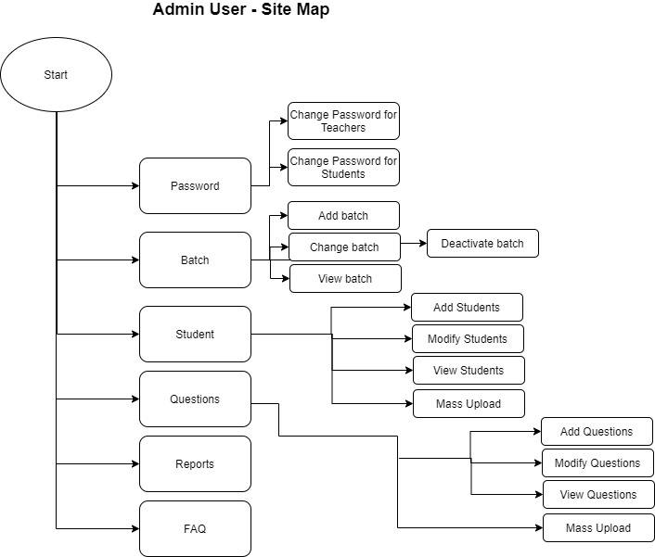
Admin User – Site Map
Need to have an option to add - Programs, Module and Facilitators

Slide 21



Student - Initial Page (after Login)
Creating Futures Skill Development App
Concepts
Examples
Exercises
Concepts
- Will be a static page that will detail the concepts based on the Topic / Level
Examples
- Will be a static page that will provide examples based on the Topic / Level
Exercises
This will be a dynamic page and questions will be shown based on the Topic / Level

Slide 22
Admin User Functionality
Create
Read
Update
Sl.No | Functionality | Description | Operations | Owner
1 | Password | Create / Change Password for Facilitators and Students | C/U
2 | Program | These are the various Programs of Creating Futures | C/R/U
3 | Modules | For every Program, we will have multiple Modules | C/R/U
4 | Facilitators | These are the Volunteers of Creating Futures | C/R/U
5 | Batch | These are sessions that we conduct for a school / college / Community / Institute | C/R/U
6 | Students | Master Data of all the students | C/R/U
7 | Question | List of all Questions (currently, we have only one type of question. Questions with 4 options) | C/R/U
8 | Reports | To be done later
9 | Home Page | List of Programs, Modules and Facilitators | View
10 | Partners | List of all our Partners (NGOs / Schools / Colleges, etc.) | C/R/U
11 | Students – Mass Upload | Mass upload of Student details from Excel Sheet | Upload
12 | Students – Download | Export to Excel Sheet | Download

Slide 23
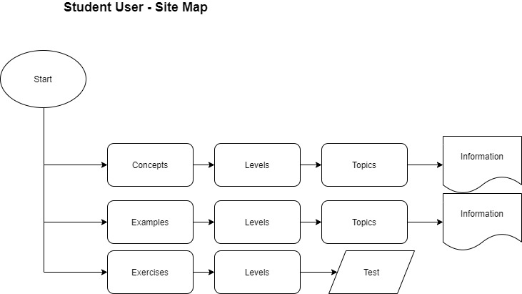
Student User – Site Map

Slide 24
Student user
Functionality
Login Screen
Home Page for Students
1st time user will have generic instructions
Repeat User will have the status of where they are
Home Page will have all the modules
The modules will have a short summary
On clicking on the particular Module, Students will go to the next level which will have three components
Concept
Examples
Exercises
Each Module (for Spoken English) will have levels
Students should go from one level to another for each of the modules

Slide 25
Student user
Taking the Test
For each level, there will be a random set of 20 questions
In Phase 1, there will be only 1 type of Question – which is “Choose from the below options”
One question will be displayed at a time
The students answers that question till (s)he gets it right
Then, the next question will be displayed
Points are received only when the student answers in the 1st attempt
If the student gets 16 or more questions correct in the 1st try, then (s)he goes to the next level

Slide 26
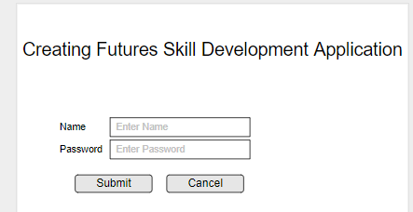
Mock-Ups: Admin – Login Screen

Slide 27
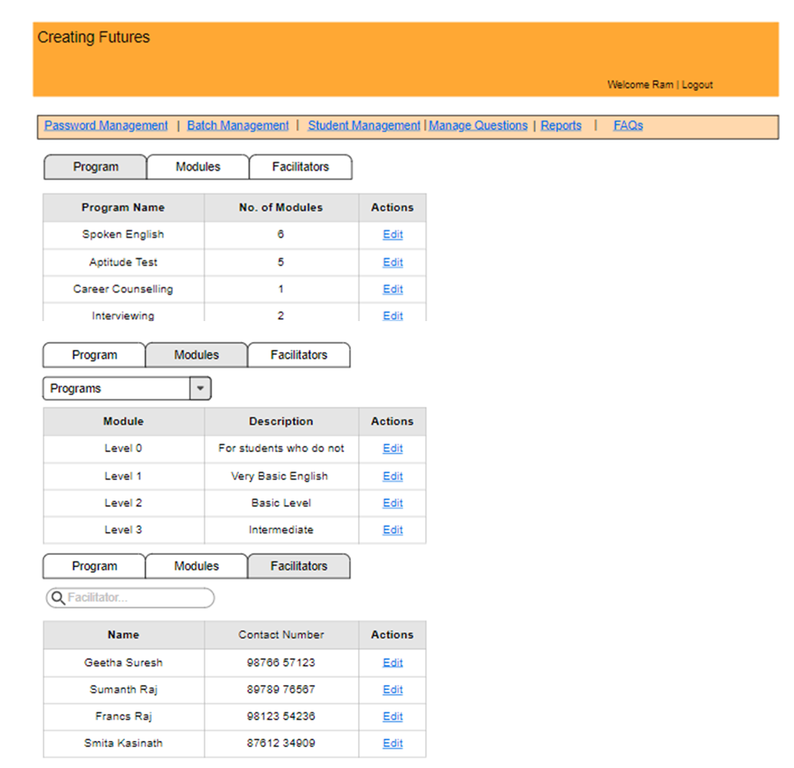
Mock-Ups: Admin – Initial Screen
Programs. This is a master list with all the Programs of Creating Futures
Modules. For each Program, there will be Multiple Modules. Example, for the Program E2E, we will have the Modules as “Resume Writing”, “Interview Skill”, etc
Facilitators. This is a master data of all Volunteers / Facilittars.

Slide 28
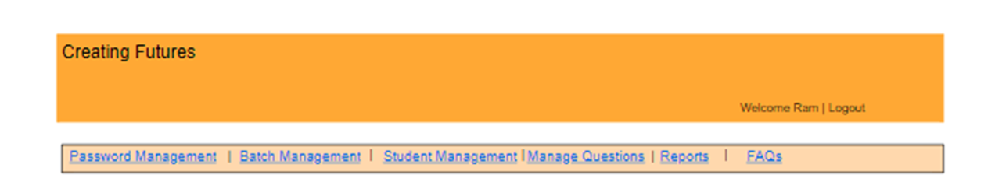
Mock-Ups: Admin – Add Program
Program ID | 2
Program Name
Pre-requisites
Comments
Submit
Cancel

Slide 29
Mock-Ups: Admin – Add Modules
Program Name | <Program Dropdown>
Module Name
Module Description
+
-
Level Id | Level Number | Level Description
1 | Level 1 | XYZ
2 | Level 2 | ABC
Each program can have multiple levels
+
-
+
-
Submit
Cancel

Slide 30
Mock-Ups: Admin – Add Facilitators
Facilitator ID | 2
First Name
Second Name
Email Id
Date of Birth
Mobile Number
Occupation
Address
Languages Known
Enrolment Date
Specific Interest
Status | <Dropdown>
Password | This will be a default Value
Admin | This will be a default Value – “N”
Comments
Submit
Cancel

Slide 31
Mock-Ups: Admin – Add Center
Center ID | 2
Center Name
Address
Contact Person
Mobile
Email Id
Center Typs | <Drop Down>
Comments
Submit
Cancel

Slide 32
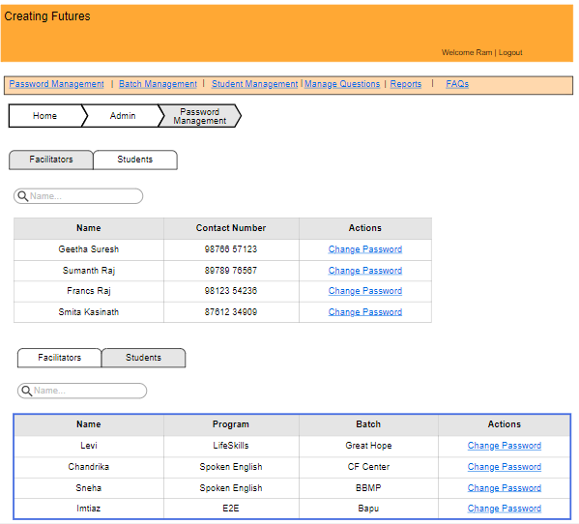
Mock-Ups: Admin – Password Management

Slide 33
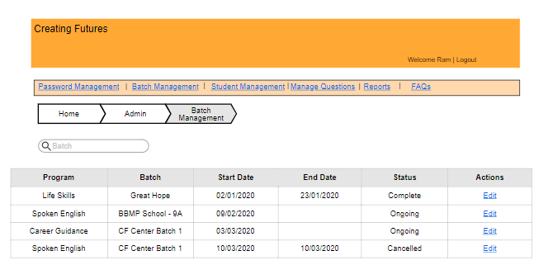
Mock-Ups: Admin – Batch Management
Add Batch

Slide 34

Mock-Ups: Admin – Add Batch
Batch ID | 2
Program | <Program Dropdown>
Batch Name
Start Date
End Date
Lead
Partner Org
Contact Number
Email Id
Location
No. of Students
No. of Sessions
Status
Comments
Submit
Cancel

Slide 35
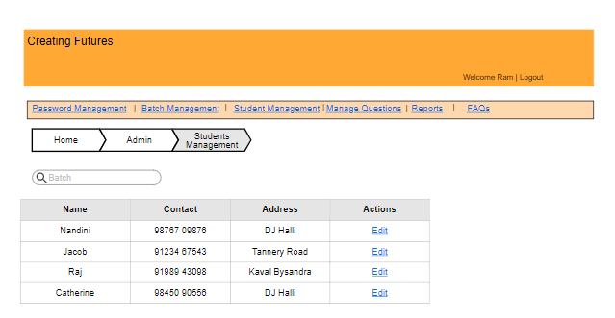
Mock-Ups: Admin – Student Management
Add Student
Bulk Upload

Slide 36

Mock-Ups: Admin – Add Student
Student ID | 2
First Name
Middle Name
Last Name
DOB
Address
Landline No.
Mobile No.
Email ID
Gender
Photo
Upload Picture
Enrollment Date
Occupation
Class
School / College
Language Known
Comments
Submit
Cancel

Slide 37
Type of Questions
Questions will be based on a Level and Topic.
The Topics for Spoken English are mentioned below
All Questions will be ‘Choosing from Options” (as part of Phase 1)
Topics
Spell Check
Word Correction
Sentence Completion
Synonyms
Antonyms
Questions
Parts Of Speech
Plural Form
Active and Passive
Fill in the blanks
Wrong Word in a Sentence

Slide 38
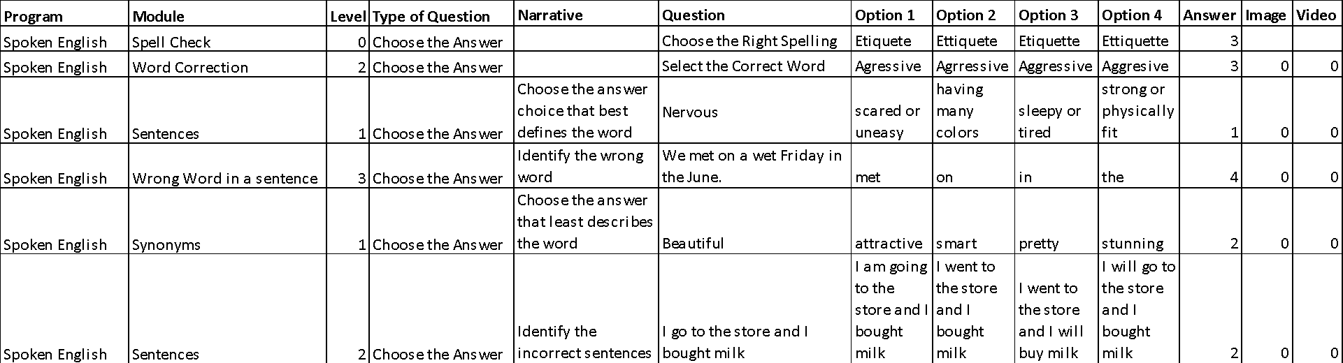
Type of Questions - Examples

Slide 39
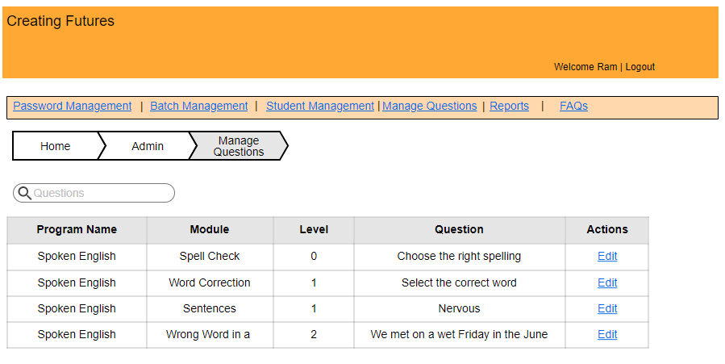
Mock-Ups: Admin – Manage Questions
Add Questions
Bulk Upload

Slide 40
Mock-Ups: Admin – Add Questions
Question ID | 2
Program
Module
Level
Type of Question
Narrative
Question
Option 1
Option 2
Option 3
Option 4
Answer
Image
Video
Submit
Cancel

Slide 41
Data Relations
Batch
Program
Facilitators
Center
Students
Modules
Not all programs should have modules
Levels
Legends
Master data
Questions
Created using master data

Slide 42

DB Design
DB Design Attached
Sheet 1 – has sample data
Sheet 2 – Data attributes

Slide 43
Mock-Ups: Student – Login Screen
Student Login

Slide 44
Mock-Ups: Home Page
Information for the student. Sample text
Spoken English
Career Guidance
Aptitude Test
MI
Interviewing
Resume Writing

Slide 45




Mock-Ups: Home Page – Spoken English
Information for the student. Sample text
Sentences
Grammar
Questions
Listening
Learn how to use English in your everyday life through Sentence Creation. Sentence level grammar covers phrases, clauses, reported speech etc.
Learn Grammar and understand how to arrange words to make proper sentences. Word level grammar covers verbs and tenses, nouns, adverbs etc.
Improve your questioning skills by practicing with questions and look at examples.
Improve your listening skills by practicing with audio and video tests. There are tests for each level: 1, 2, 3, 4, 5. You will be able to see the progress you have made through these tests
Words
Writing
Conversation
Reading

Slide 46
Mock-Ups: Module Page (sentences)
Learn how to Speak English through Sentences
Level 1 Sentences Exercises
Level 2 Sentences Exercises
Level 3 Sentences Exercises
Level 1 Lessons and Examples
Level 2 Lessons and Examples
Level 3 Lessons and Examples
Level 4 Sentences Exercises
Level 5 Sentences Exercises
Level 6 Sentences Exercises
Level 4 Lessons and Examples
Level 5 Lessons and Examples
Level 6 Lessons and Examples

Slide 47
LEVEL 1
LEVEL 2
LEVEL 3
1
2
3
Assessment | AV Test | Image Test
Crosswords | Word search
Assessment | AV Test | Image Test
Crosswords | Word search
Assessment | AV Test | Image Test
Crosswords | Word search
Take Lesson | Examples
Take Lesson | Examples
Take Lesson | Examples
LEVEL 4
LEVEL 5
LEVEL 6
4
5
6
Assessment | AV Test | Image Test
Crosswords | Word search
Assessment | AV Test | Image Test
Crosswords | Word search
Assessment | AV Test | Image Test
Crosswords | Word search
Take Lesson | Examples
Take Lesson | Examples
Take Lesson | Examples

Slide 48

Mock-Ups: Exercise Page (sentences)
Exercise on Sentences - Level 1
Question 1
Jawaharlal spent his childhood ______ Anand Bhawan.
(A) at
(B) in
(C) on
(D) across
Jawaharlal spent his childhood in Anand Bhawan.
Next Q
This is incorrect. Try again

Slide 49
Mock-Ups: Exercise Page (sentences)
Exercise on Sentences - Level 1
You have completed this test.
Correct answers: 10/20.
Your score is 50%.
Try again to go to the next level
Check your answers here
You have completed this test.
Correct answers: 20/20.
Your score is 100%.
Congratulations. You have moved to the next level
Check your answers here

